Slide 1

Efficient Neural Architecture Search via Parameter Sharing
HieuPham* MelodyY.Guan* BarretZoph QuocV.Le JeffDean
Google Brain
Language Technology Institute, Carnegie Mellon University
Department of Computer Science, Stanford University
ICML, 2018
Reporter: Tang Qidong, 2020.11/18
Notes:
The paper I present today is “Efficient Neural Architecture Search via Parameter Sharing ”
It was published on ICML 2018. The authors are from google brain and Carnegie Mellon University, Standard University.

Slide 2
Outline
Overview of NAS
Motivation and Contribution
Methods
Experiments and Thinking
Notes:
My presentation will expand from the following four parts.
Firstly, I will introduce the overview of NAS.
Then, I will state the motivation and contribution.
Next, I will describe the methods of ENAS in detail.
Finally, I will introduce the experiments and the results.

Slide 3
Neural Architecture Search (NAS)
Policy Gradient Strategy
Notes:
As shown in this Figure, the classic NAS method uses a RNN as the controller to generate a child network(sub-network). Then train the child-network and evaluate it to obtain its network performance. (such as the classification accuracy), Finally its performance will be used as the reward to update the controller parameters. However, the performance of the child-network is not differentiable, and we cannot directly optimize the controller using stochastic gradient descent. Fortunately, Reinforcement Learning is a powerful tool. With RL, we can use the policy gradient strategy to directly update the controller parameters.

Slide 4
Problem of NAS
The computational bottleneck of NAS is the training of each child model to convergence, only to measure its accuracy whilst throwing away all the trained weights. (i.e. 32,400-43,200 GPU hours for CIFAR10)
Detailly, NAS trains a child network to converge each time in order to get the corresponding reward. And then the reward is fed to the RNN controller for the updating of controller parameters. But in the next round of training the child network, the training is started from the beginning, and the training results of the previous rounds of the child network are not used.
Notes:
There is some problem of the most common NAS.

Slide 5
Contribution
The main contribution of this work is to improve the efficiency of NAS by forcing all child models to share weights to eschew training each child model from scratch to convergence.
Notes:
So in order to solve the bottleneck of NAS, this paper proposes a much faster and efficient approach for automatic model design, named ENAS.

Slide 6
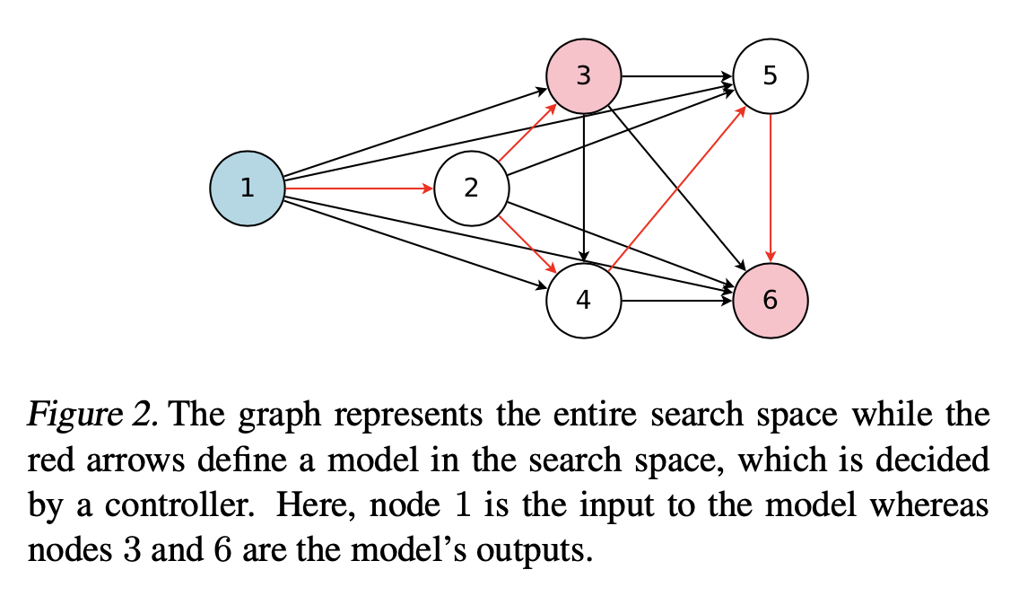
Methods
In ENAS, the search space is represented as a single directed acyclic graph (DAG). A DAG is the superposition of all possible child models.
The nodes represent the local computations and the edges represent the flow of information.
Notes:
Next, I will describe the methods of ENAS in detail.
In ENAS, the search space is represented as a single directed acyclic graph, abbreviated as DAG. A DAG is the superposition of all possible child models. As shown in the figure, there are 6 nodes in the DAG, with all possible edges.
A sub-graph taken from the DAG represents a child model. The nodes represent the local computations and the edges represent the flow of information.

Slide 7
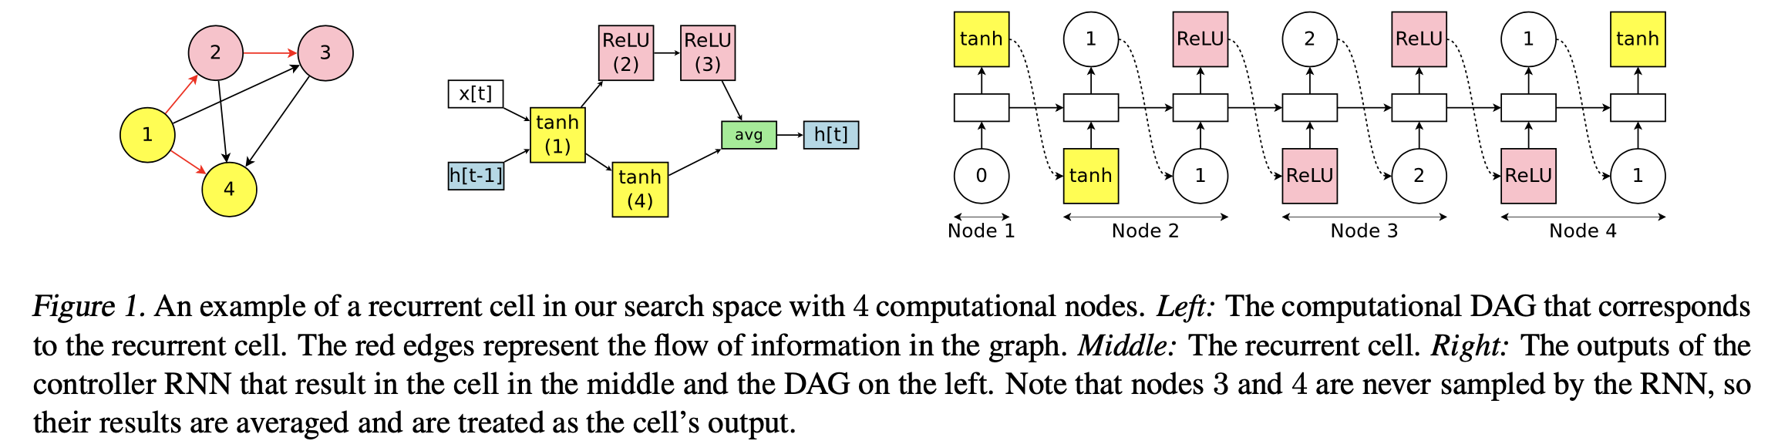
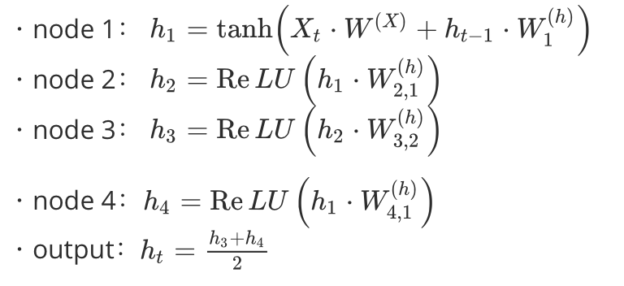
1.Designing Recurrent Cells
ENAS’s controller decides:
1). which edges are activated.
2). which computations are performed at each node in the DAG.
Notes:
For the first part, I will introduce how the ENAS design a recurrent cell.
The controller of ENAS is an RNN that decides: 1) which edges are activated and 2) which computations are performed at each node in the DAG. To create a recurrent cell, the controller need to sample N blocks of decisions. And the figure above illustrates the ENAS mechanism via a simple example recurrent cell with N = 4 computational nodes.
Node 1 takes x_t as the input signal, and it needs to sample an activation function. It chooses tanh in the Schematic diagram.
For the node 2,3,4, they need to samples a previous index and an activation function. Take node 4 as an example, it samples node 1 as input as ReLU as the activation function.

Slide 8
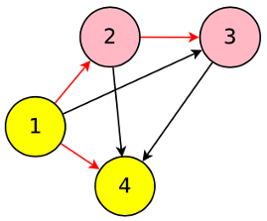
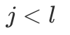
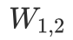
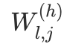
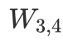
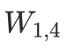
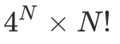
Parameter Sharing in RNN
In the example above, we note that for each pair of nodes , there is an independent parameter matrix . . By choosing the previous indices, the controller also decides which parameter matrices are used.
If the recurrent cell has N nodes and we allow 4 activation functions (tanh, ReLU, identity, and sigmoid), then the search space has configurations.
Notes:
In the example above
(For any child model, as long as node 4 chooses node 1 as input this time, then W1,4 will be used).
If the recurrent …… N power of 4 multiplies n factorial.

Slide 9
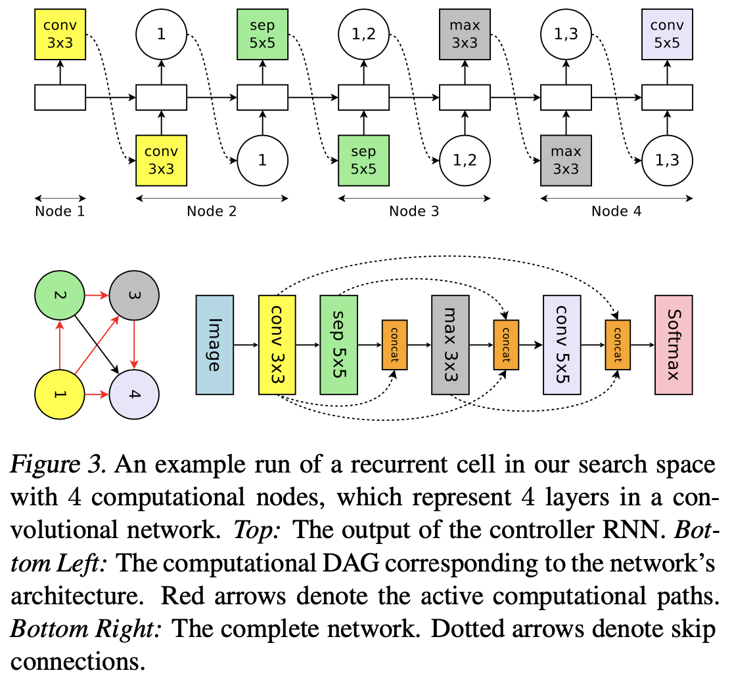
2.Designing Convolutional Networks
ENAS’s controller samples :
1) what previous nodes to connect to.
2) what computation operation to use.
 | Previous Nodes | Operation
Node 1 | Previous cell output | Conv 3X3
Node 2 | Node 1 | Depthwise-separable conv
Node 3 | Node 1,2 | Maxpool 3X3
Node 4 | Node 1,3 | Conv 5X5
Notes:
For the second part, I will introduce how the ENAS design a convolutional Network.
In the search space for convolutional models, the controller RNN also samples two sets of decisions at each decision block: 1) what previous nodes to connect to and 2) what computation operation to use.
There are totally 6 operations to choose for each node. There are 4 nodes in the example shown in the figure, at layer k = 4, the controller samples previous indices {1, 3}, so the outputs of layers 1 and 3 are concatenated along their depth dimension and sent to layer 4.

Slide 10
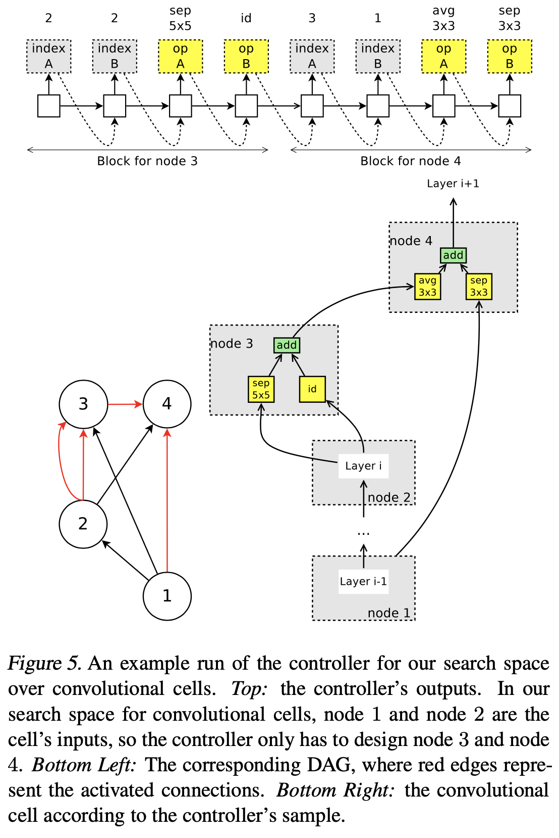
3. Designing Convolutional Cell
Rather than designing the entire convolutional network, ENAS design smaller modules and then connect them together to form a network
ENAS’s controller samples :
1) Two previous nodes to be used as the inputs to the current node.
2) Two operations to apply to the two sampled nodes.
If there are multiple loose ends, they will be concatenated along the depth dimension to form the cell’s output.
Notes:
Rather than designing the entire convolutional network, Another idea is to design smaller modules and then connect them together to form a network. In the third part, I will describe how to use ENAS to search for the architectures of convolutional cells.
In each cell, node 1 and node 2 are treated as the cell’s inputs. For the other nodes, the controller needs to sample 1) Two previous nodes to be used as the inputs to the current node. 2) Two operations to apply to the two sampled nodes.
(For node 4, it chooses node 1 and node 3 as inputs, and chooses average pooling and separable convolution as operation)
If there are multiple loose ends, they will be concatenated along the depth dimension to form the cell’s output.

Slide 11
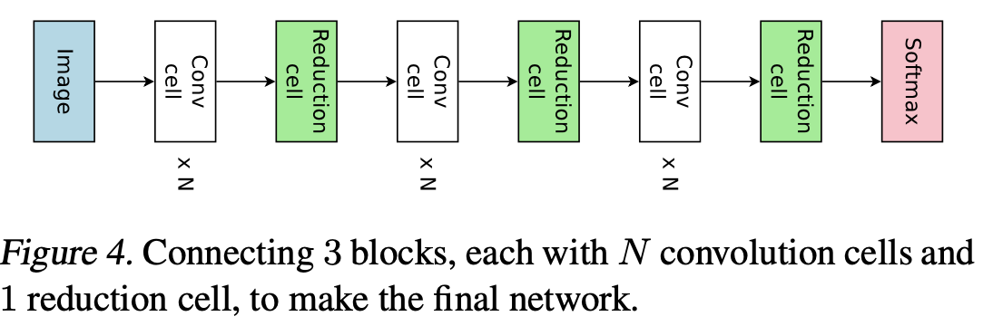
3. Designing Convolutional Cell
Two types of Cells: Normal Conv Cell , Reduction Cell
For Reduction Cell: Applying all operations with a stride of 2 (thus reduces the spatial dimensions of its input by a factor of 2 )
Notes:
For the convolutional cell, there are 2 types. The first is Normal Conv Cell, and the other is Reduction Cell.
The generation of Reduction Cell is the same as Normal Conv Cell, except that for reduction cell, we need to apply all operations with a stride of 2 (thus reduces the spatial dimensions of its input by a factor of 2 )

Slide 12
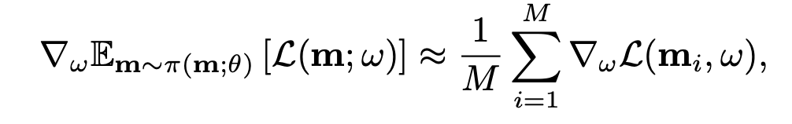
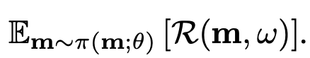
4.1 . Training ENAS
Two sets of learnable parameters:
1) the parameters of the controller LSTM, denoted by θ;
2) the shared parameters of the child models, denoted by ω.
Training the shared parameters ω of the child models.
Training the controller parameters θ
Maximize the expect reward
Expected Loss Function
Notes:
For the fourth part, I will introduce how to train ENAS and how to derive the final architecture.
In ENAS, there are two sets of learnable parameters: the parameters of the controller LSTM, denoted by θ, and the shared parameters of the child models, denoted by ω. The training procedure of ENAS consists of two interleaving phases. The first phase trains ω, the shared parameters of the child models, on a whole pass through the training data set.
When training the shared parameters ω, we fix the controller’s policy π(m;θ) and perform stochastic gradient descent (SGD) on ω to minimize the expected loss function Em∼π [L(m;ω)].
(L(m; ω) is the standard cross-entropy loss, computed on a minibatch of training data, with a model m sampled from π(m; θ). The gradient is computed using the Monte Carlo estimate ) Actually in practice, M is set as 1.
The second step is to train the controller parameters θ. In this step, we fix ω and update the policy parameters θ, aiming to maximize the expected reward Em∼π(m;θ) [R(m, ω)] . The reward R(m,ω) is computed on the validation set, rather than on the training set, to encourage ENAS to select models that generalize well rather than models that overfit the training set well.

Slide 13
4.2 . Deriving Architectures
First sample several models from the trained policy π(m,θ)
For each sampled model, compute its reward on a single minibatch sampled from the validation set. Then take only the model with the highest reward to retrain from scratch.
Notes:
As how to derive novel architectures from a trained ENAS model. First sample several models from the trained policy π(m,θ). For each sampled model, compute its reward on a single minibatch sampled from the validation set. And then take only the model with the highest reward to re-train from scratch.
(It is possible to improve our experimental results by training all the sampled models from scratch and se- lecting the model with the highest performance on a separated validation set )

Slide 14
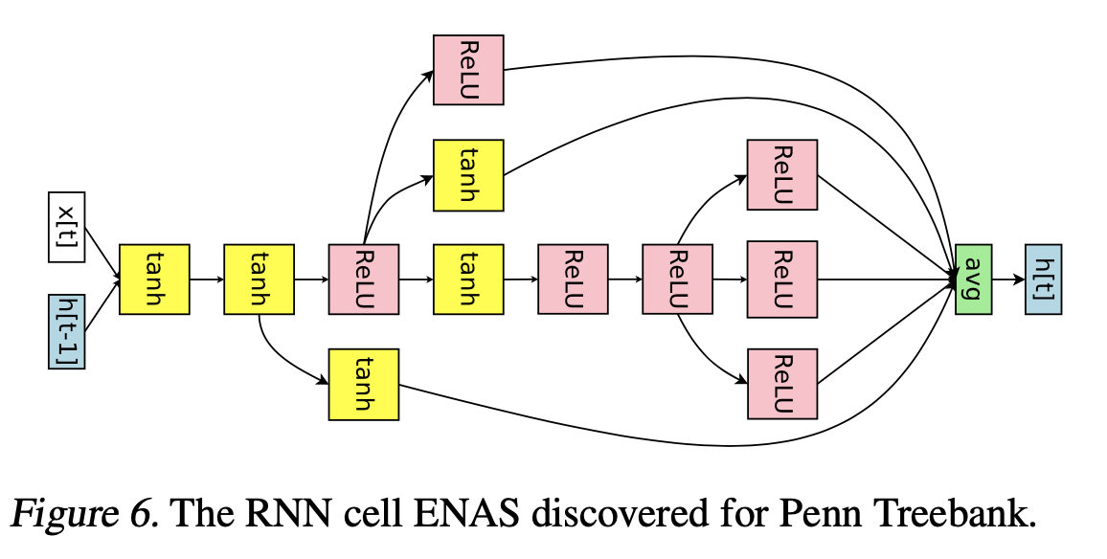
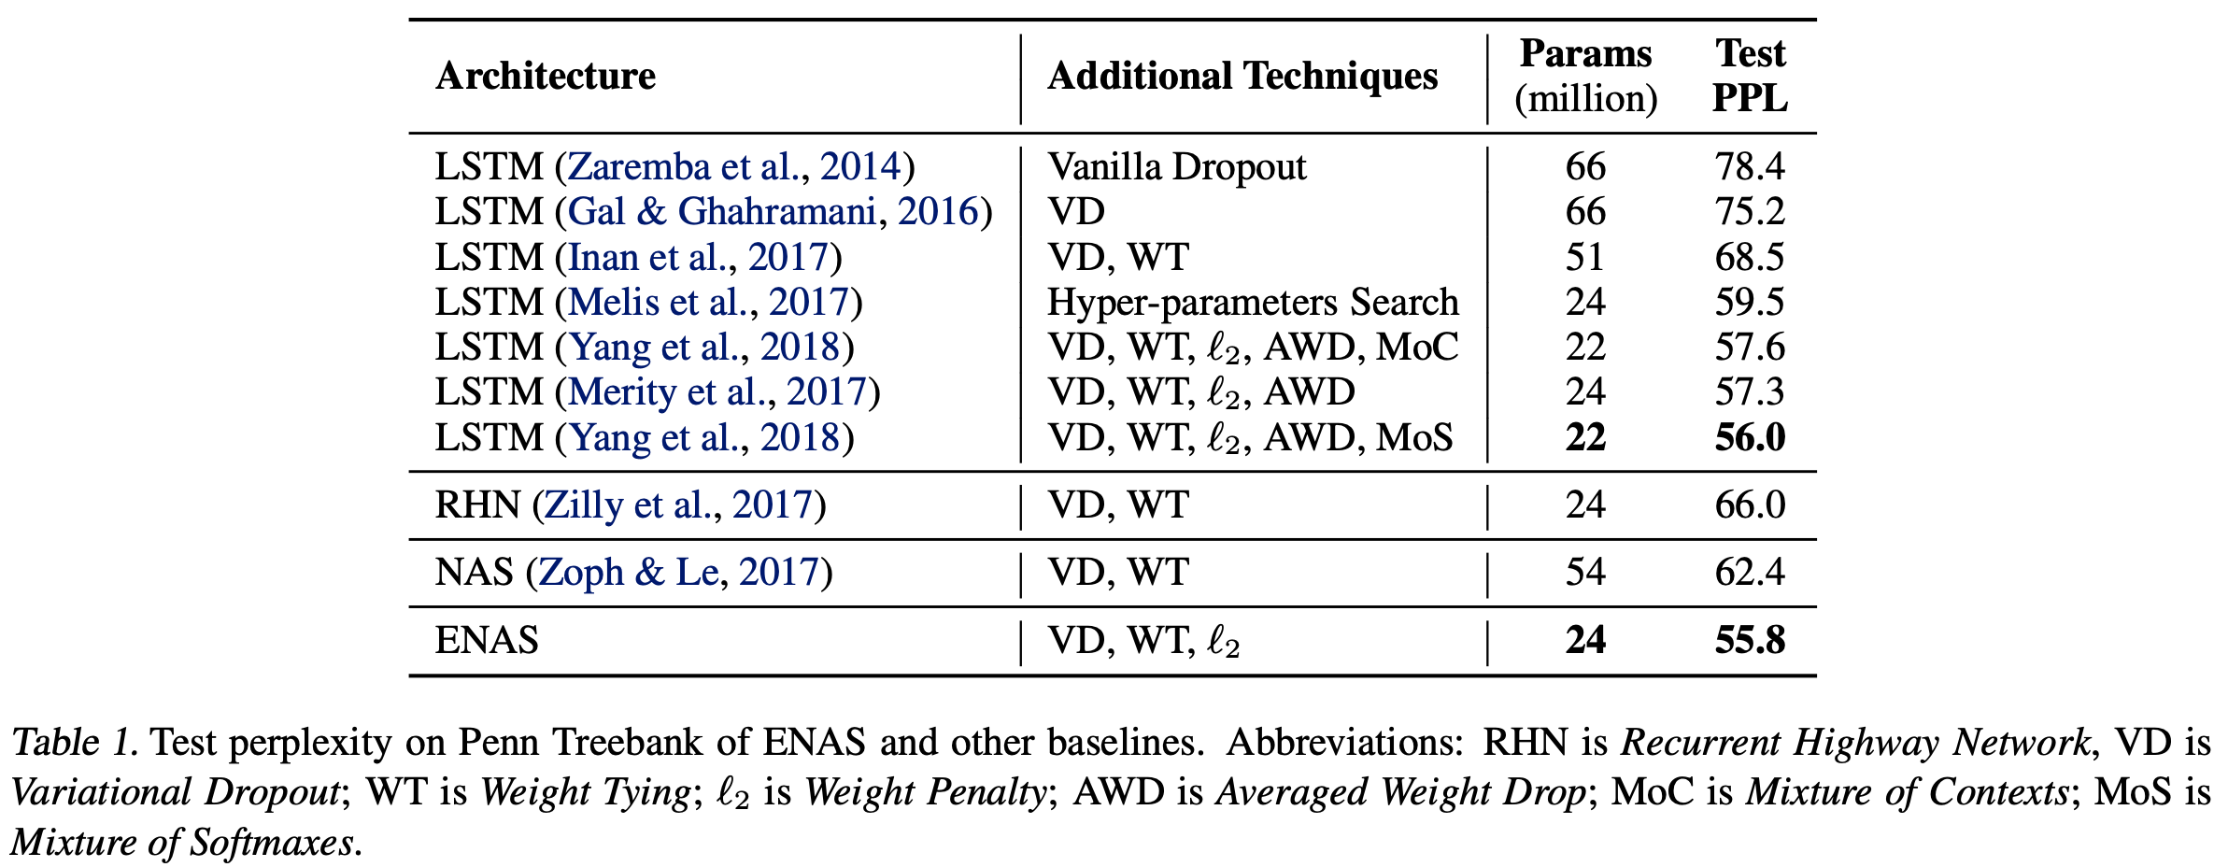
Experiments (Language Model with Penn Treebank)
Interesting Properties:
1) All non-linearities in the cell are ei- ther ReLU or tanh (without identity , sigmoid)’
2) Randomly pick some nodes and switch the non-linearity function, perplexity increases
3) The output of ENAS cell is an average of 6 nodes, similar to Mixture of Contexts(MoC).
Better Performance than NAS and other manually designed Network
Notes:
The first experimental results are from employing ENAS to design recurrent cells on the Penn Treebank dataset.
Running on a single Nvidia GTX 1080Ti GPU, ENAS finds a recurrent cell in about 10 hours. The ENAS cell achieves a test perplexity of 55.8, which is on par with the existing state-of-the-art. It is better than all other search-based neural network as well as other manually-designed network.
The ENAS cell shown at upper left has a few interesting properties.
First, all non-linearities in the cell are either ReLU or tanh, even though the search space also has two other functions: identity and sigmoid.
Second, this cell is a local optimum. When we randomly pick some nodes and switch the non-linearity into identity or sigmoid, the perplexity increases up to 8 points. Similarly, when we randomly switch some ReLU nodes into tanh or vice versa, the perplexity also increases, but only up to 3 points.
the output of our ENAS cell is an average of 6 nodes. This behavior is similar to that of Mix- ture of Contexts (MoC)

Slide 15
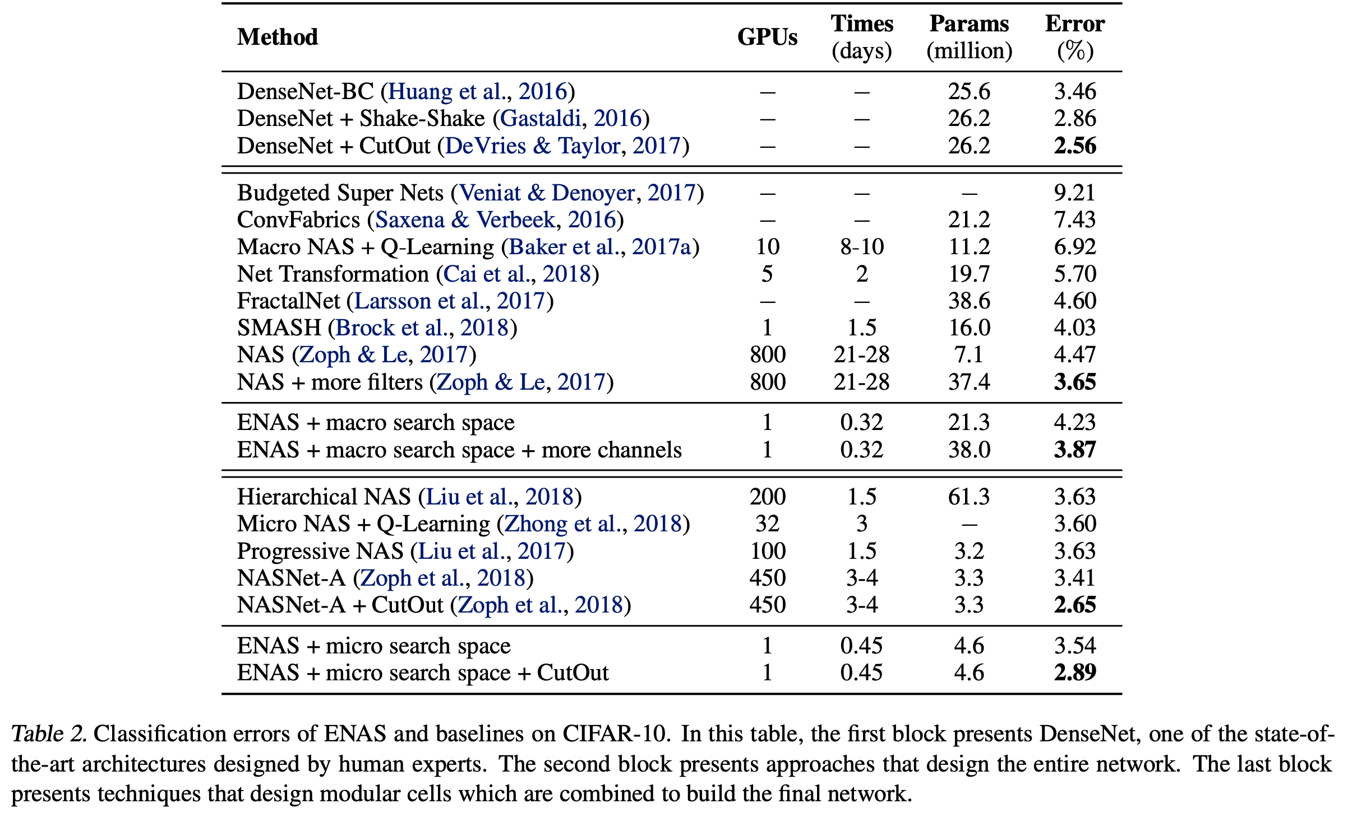
Experiments (Image Classification on CIFAR-10)
Notes:
ENAS的最终结果不如NAS，这是因为ENAS没有像NAS那样从训练后的controller中采样多个模型架构，然后从中选出在验证集上表现最好的一个。但是即便效果不如NAS，但是ENAS效果并不差太多，而且训练效率大幅提升。 The final result of ENAS is not as good as NAS. This is because ENAS does not sample multiple model architectures from the trained controller like NAS, and then select the one that performs best on the validation set. But even if the effect is not as good as NAS, the effect of ENAS is not too bad, and the training efficiency is greatly improved.

Slide 16
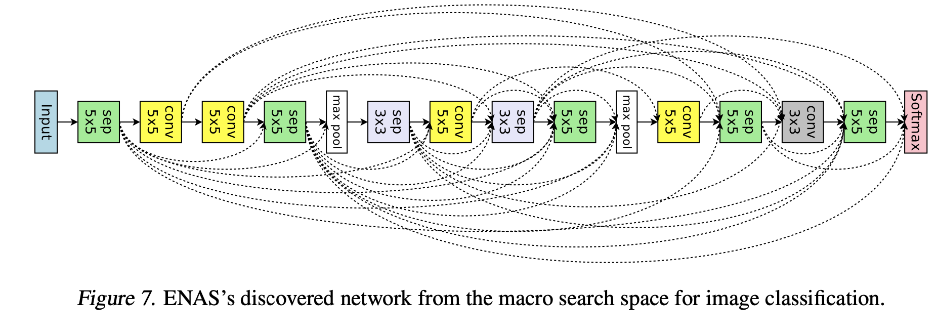
Experiments (Image Classification on CIFAR-10)
The models found by ENAS are, in a sense, the local minimums in their search spaces.
If replace all separable convolutions with normal convo- lutions, and then adjust the model size so that the number of parameters stay the same, then the test error increases by 1.7%.
if we randomly change several connec- tions in the cells that ENAS finds in the micro search space, the test error increases by 2.1%.

